Slide 1
Introduction to Data Science
Nicholas Mattei, Tulane University
CMPS3660 – Introduction to Data Science – Fall 2019
https://rebrand.ly/TUDataScience
Many Thanks
Slides based off Introduction to Data Science from John P. Dickerson - https://cmsc320.github.io/

Slide 2

Introduction to ???????
Many Thanks
Slides based off Introduction to Data Science from John P. Dickerson - https://cmsc320.github.io/

Slide 3
Data science is the application of computational and statistical techniques to address or gain [managerial or scientific] insight into some problem in the real world.
Zico Kolter
Machine Learning Prof, CMU

Slide 4
Data science comprises three distinct and overlapping areas: the skills of a statistician who knows how to model and summarize datasets; the skills of a computer scientists who can design and use algorithms to efficiently store, process, and visualize the data; and the domain expertise necessary to formulate the right question and put the answers in context
Jake VanderPlas
Author, Python Data Science Handbook

Slide 5
The goal of data science is to improve decision making based on insights from data. As a field, Data Science encompasses a set of principles, problem definitions, algorithms, and processes for extracting nonobvious and useful patterns from datasets.
John D. Kelleher and Brendan Tierney
Authors, Data Science (MIT Press)

Slide 6
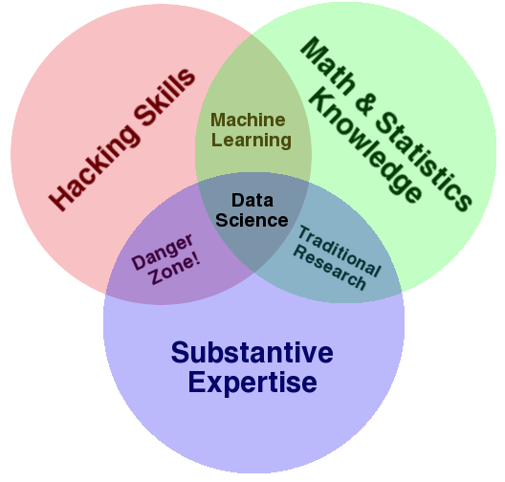
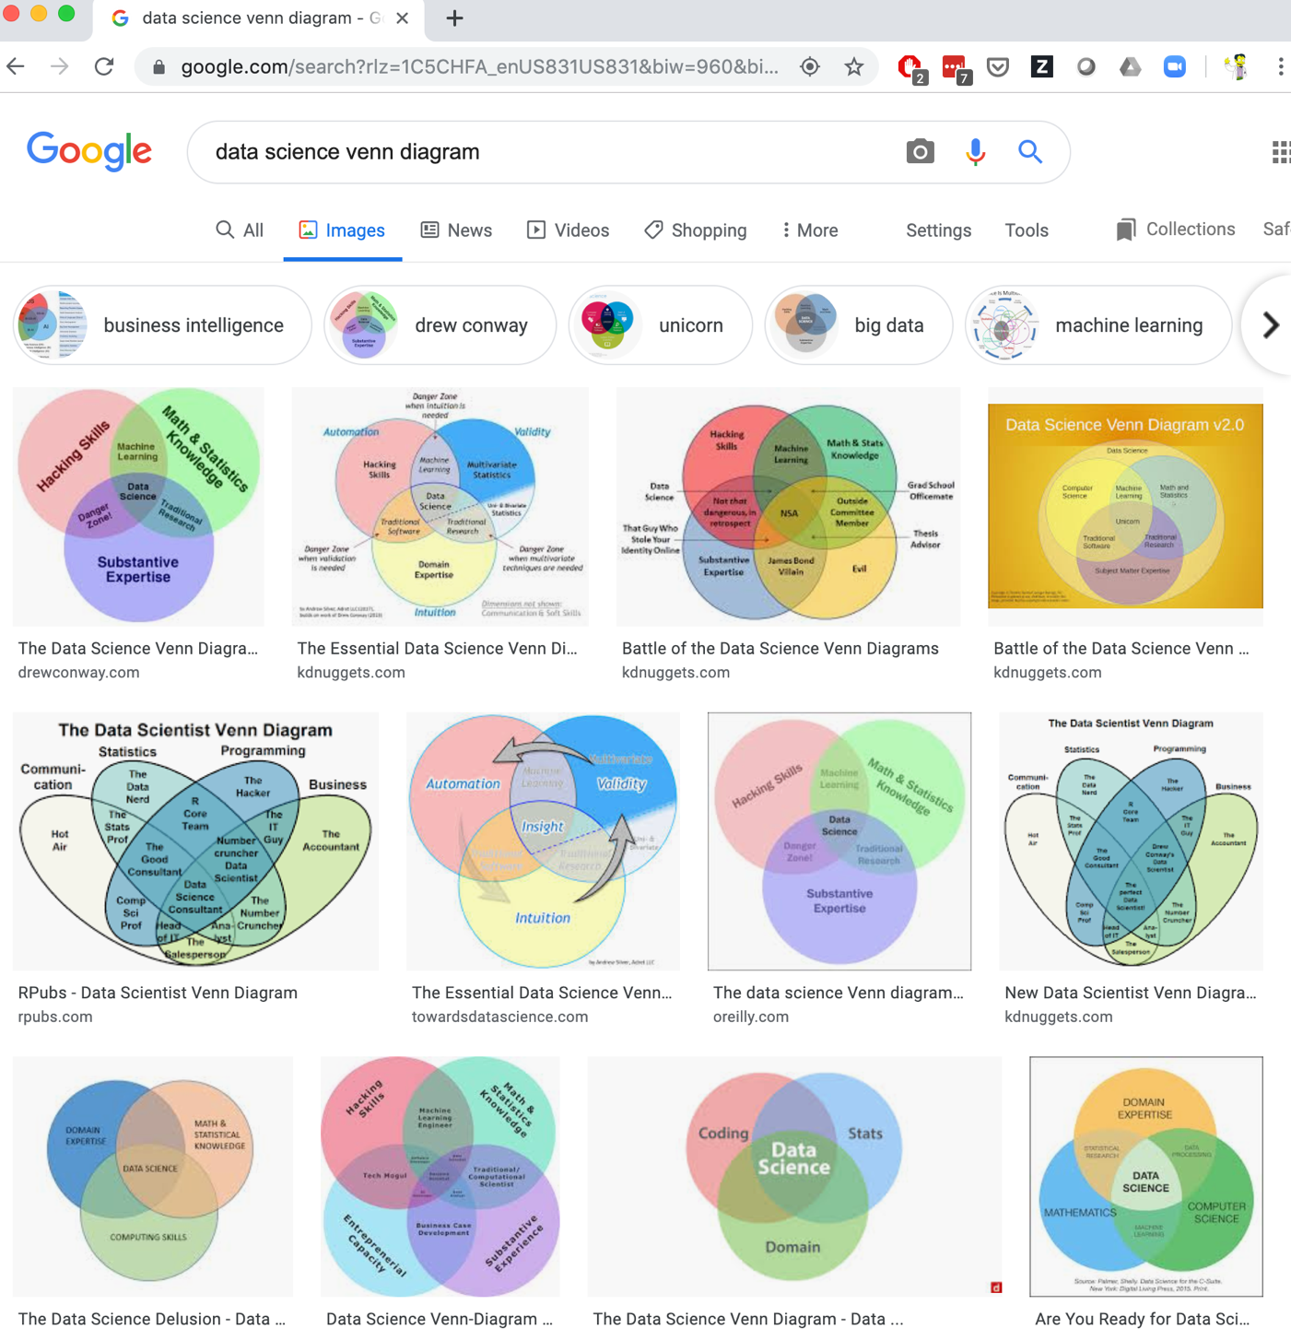
The battle of the Data Science Venn Diagrams -- https://www.kdnuggets.com/2016/10/battle-data-science-venn-diagrams.html
Drew Conway
CEO, Alluvium (analytics company)

Slide 7
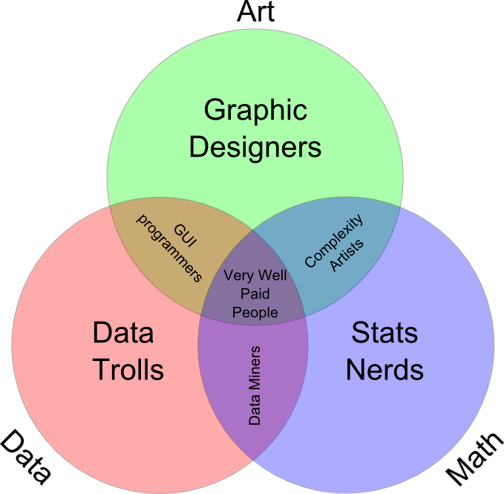
Many definitions
Broad: necessarily larger than a single discipline
Interdisciplinary: statistics, computer science, operations research, statistical and machine learning, data warehousing, visualization, mathematics, information science, …
Insight-focused: grounded in the desire to find insights in data and leverage them to inform decision making
Tuomas Carsey, UNC

Slide 8
The Data LifeCycle
Data Collection
Data Processing
Exploratory Analysis
&
Data Visualization
Analysis, Hypothesis Testing,
& ML
Insight
&
Policy Decision

Slide 9
The CRISP-DM LifeCycle
From IBM Data LifeCycle: https://www.ibm.com/support/knowledgecenter/SS3RA7_18.2.0/modeler_crispdm_ddita/clementine/crisp_help/crisp_overview_container.html
Going around around (sometimes these projects never end, e.g., Tugboats.)…

Slide 10
Data Science Pyramid
Decision
Making
Data Aggregation, Preprocessing, and Warehousing
Machine Learning / Prediction / Hyp. Testing
Data Exploration
Data Sources and Gathering
Adapted from Data Science, Kelleher and Tierney – Taken from Data Mining by Han, Kamber, and Pei.
Related to the DIKW Pyramid - https://en.wikipedia.org/wiki/DIKW_pyramid

Slide 11
“The ability to take data—to be able to understand it, to process it, to extract value from it, to visualize it, to communicate it—that’s going to be a hugely important skill in the next decades, not only at the professional level but even at the educational level for elementary school kids, for high school kids, for college kids.”
Hal Varian
Chief Economist at Google
Hal Varian

Slide 12

This Course
You’ll learn to take data:
Process it; Visualize it; Understand it; Communicate it; Extract value from it
At the conclusion of this course students will be able to:
Open, load, and manipulate data using industry standard tools.
Have a basic understanding of data management and storage systems.
Be able to clean data and perform basic statistical analysis of the data including visualization.
Have an understanding of statistical hypothesis testing including t-tests and bootstrapped confidence intervals.
Be able to use one or more machine learning algorithms for classification, regression, and prediction of data.
Be able to present the results of a complete data analysis in written, visual, and presentation.

Slide 13
Overview
Course Webpage:
https://rebrand.ly/TUDataScience
We will use this post all course material including projects, readings, and slides.
Quizzes and projects will be turned in through Canvas / GitHub.
Time and Place
Lectures: Tuesdays and Thursdays
Room: Stanly Thomas 302 (Building 10)
Time: 1100 – 1215

Slide 14
Course Staff
Instructor: Prof. Nicholas Mattei
Office: Stanley Thomas 402B
Office Hours: TBD?!?!?
Email: nsmattei@tulane.edu
Research Interests: AI, ML, data science, decision making… (this class!)
TA: Arie Glazer
Email: aglazier@tulane.edu
Office: Stanley Thomas 309
Office Hours: MW 1400-1500

Slide 15
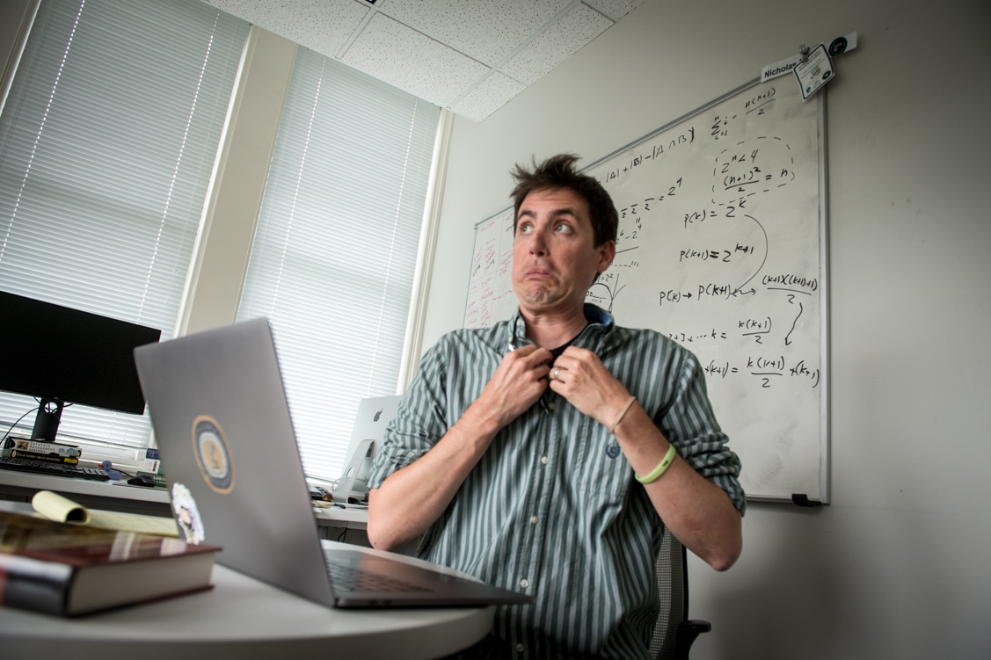

Who am I?
Undergrad/Masters University of Kentucky
Worked at NASA Ames Research Center (Bay Area)
PhD University of Kentucky
NICTA / UNSW / Data61 / CSIRO (Sydney, Australia)
IBM Research (New York)
Tulane University!

Slide 16
This Course is an EXPERIMENT!
Please speak up if things aren’t working, we’re going to fast, or we’re going too slow.
Trying some new things like in class Lab sessions!
I have a tendency to speak fast, please tell me to slow down!
The schedule is subject to change – please keep checking and I’ll remind you of any changes!
Most important: let’s have fun and learn some cool stuff!

Slide 17
Prerequisite Knowledge
Aimed at TU:CS Undergrads – but likely accessible to others with programming experience and mathematical maturity.
We do not assume:
Extensive experience with Python, pandas, scikit-learn, matplotlib, etc …
Deep statistics or any ML knowledge
Database or distributed systems knowledge
We do assume:
Some Familiarity with Python and/or programming.
You are comfortable with topics in Discrete Math (sets, probability, counting).
You want to be here!

Slide 18
Some Technologies we will use
Notes:
Docker – containerization, build and ship apps
Spark – cluster computing framework, nice data parallelism etc

Slide 19
You really don’t need anything else…

Slide 20
Who are you? -- https://rebrand.ly/DSQuestions

Slide 21
Required Materials
There is no required textbook for this course. However, we will make extensive use of online textbooks and articles for the required reading that you will be quizzed on.
You will also need access to a computer that you can install the required software (Anaconda, Docker). If you do not have access to a computer that you can install software on please see me ASAP.
Online Books:
Python Data Science Handbook: Essential Tools for Working with Data, Jake VanderPlass. O’Reilly Media Inc., 2016. Available online for free at: https://github.com/jakevdp/PythonDataScienceHandbook
Computational and Inferential Thinking: The Foundations of Data Science, Ani Adhikari and John DeNero. A free online textbook that includes interactive Jupyter notebooks and public data sets for all examples at: https://www.inferentialthinking.com/chapters/intro

Slide 22
(Tentative) Course structure
First Lecture: Intro!
Next 4 lectures (2 weeks): intro & primers in the Python data science stack and tools
Next 7 lectures (3.5 weeks): data collection & management
Best practices, data wrangling, exploratory analysis, ethics, debugging, visualization, etc …
Midterm
4 Lectures (2 weeks) after fall break: basic probability, statistical testing, bootstrap.
9 Lectures (4.5 weeks): Machine learning tools, NLP, regression, classification etc.
2 Lectures (1 week): In class presentations of projects.
Ambitious …
We have 29 total lectures.
Dr. Mattei gone for 3 (1 Midterm)
Class Presentations for 2
We have 24 (-1 for intro) content lectures and so many things we can cover!!

Slide 23
Grading
15% - (Mostly) Weekly Questions
40% - Mini-Projects and Labs
15% - Midterm Exam
30% - Final Project
All grades will be posted on Canvas.
A >= 90% B >= 80% C >= 70%
D >= 60% F < 60%
+/- grades will be given for borderline cases.

Slide 24
15% - Weekly Questions
~10 - 12 Weekly Questions
Will be assigned on Canvas.
Will cover posted articles, tutorials, and in class lectures.
Will be short answer and multiple guess.
Typically will be assigned on Tuesdays and due by Midnight the following Tuesday.
No late work allowed.
Requests for an extension (with a valid reason) must be given to the instructor before the questions are due.

Slide 25

Mini-Projects and Labs (40%)
Students will complete mini-project and lab assignments:
Exercises showing you are comfortable with the data science stack.
Typically in class Labs!
Case studies meant to mimic what you, a future data scientist, will see in industry.
They should be fun
The rules:
Allowed: small group discussions
Required: individual programming & writing
Never Allowed: public posting of solutions
Also Never Allowed: paying someone to do your work!
Deliverable:
Turn in an .ipynb of a Jupyter notebook on Canvas
First project is already posted (getting Github and your environment setup).

Slide 26
Midterm Exam (15%)
You know what this is.
Will cover roughly the first 3/5 of class:
Qualitative (more)
Quantitative (less)
Currently scheduled for October 3rd (might change)

Slide 27
Final Tutorial (30%)
In lieu of a final exam, you’ll (individual or group) create a mini-tutorial that:
Identifies a raw data source; processes and stores that data
Performs exploratory data analysis & visualization
Derives insight(s) using statistics and ML
Communicates those insights as actionable text
Deliverables (we will have several milestones as the semester goes):
URL of your own GitHub Pages site hosting an .ipynb/.html export of your final tutorial.
10 min in class presentation of the tutorial (TBD based on number of groups).
The project itself:
~1500+ words of Markdown prose, ~150+ lines of Python
Should be viewable as a static webpage – that is, if I (or anyone else) opens the link up, everything should render and I shouldn’t have to run any cells to generate output
Example writeup:
https://andresgogo.github.io/

Slide 28
Final Tutorial Milestones (Running Notebook)
Partners and Datasets (Oct. 1)
1 page writeup listing a partner (if any) and one to three datasets that you are considering working with and why. This is just an outline to make sure you are thinking. This will be published on your GitHub IO page so this also makes sure you’ve figured out how to get it uploaded!
Extraction, Transform, and Load (ETL) + Exploratory Data Analysis (EDA) (Oct. 22).
Your notebook from Part 1 but expanded to include the data being loaded and showing that you have figured out how to get the data into your system.
Your notebook expanded to include some graphs, visualizations, and stats that show you can manipulate your data and understand the dataset you are working with.
Final Presentation (Dec 3 + Dec 5).
Your in class presentation.
Final Tutorial (???)
Your posted final tutorial.

Slide 29
Final Tutorial Rubric (More info to come…)
Grade on a scale of 1-10:
Motivation: Does the tutorial make the reader believe the topic is important (a) in general and (b) with respect to data science?
Understanding: After reading the tutorial, does the reader understand the topic?
Further resources: Does the tutorial “call out” to other resources that would help the reader understand basic concepts, deep dive, related work, etc?
Prose: Does the prose in the Markdown portion of the .ipynb add to the reader’s understanding of the tutorial?
Code: Does the code help solidify understanding, is it well documented, and does it include helpful examples?
Subjective Evaluation: If somebody linked to this tutorial from Hacker News, would people actually read the whole thing?
Presentation: Is the in class presentation well constructed? did you identify all the important bits of your tutorial? was the presentation engaging?

Slide 30
Some Data Set Options…
https://www.data.gov/
US-centric agriculture, climate, education, energy, finance, health, manufacturing data, …
https://cloud.google.com/bigquery/public-data/
BigQuery (Google Cloud) public datasets (bikeshare, GitHub, Hacker News, NOAA, …)
https://www.kaggle.com/datasets
Billboard Top 100 lyrics, credit card fraud, crime in Chicago, global terrorism, world happiness, …)
https://aws.amazon.com/public-datasets/
AWS-hosted, various (NASA, a bunch of genome stuff, Google Books n-grams, Multimedia Commons, …)
Data is Plural: https://tinyletter.com/data-is-plural
https://docs.google.com/spreadsheets/d/1wZhPLMCHKJvwOkP4juclhjFgqIY8fQFMemwKL2c64vk/edit#gid=0 - Lots of interesting and strange datasets.
Corgies Datasets: https://think.cs.vt.edu/corgis/
GitHub Awesome Public Datasets: https://github.com/awesomedata/awesome-public-datasets
Think Stats Datasets: https://docs.google.com/spreadsheets/d/e/2PACX-1vQlv2BpO7TsU2UAE7iQwCUxvxn9LTXEPPj5EnA0l9-DJSwCDZU0xg_IhWBItZ7bNvZ_BnznuOrYYy0i/pubhtml

Slide 31
Class Attendance and Participation
Class attendance
Class attendance will be taken almost every day.
Please please please do the readings (if possible) before so we can talk about them!
Students are responsible for notifying instructors about absences that result from serious illnesses, injuries, or critical personal problems
Students with frequent absences will be reported and/or removed from the course according to university policy.

Slide 32
Electronic Devices
Please silence your phones!
If you want to use a laptop please move to the back of the class
https://www.scientificamerican.com/article/students-are-better-off-without-a-laptop-in-the-classroom/
EXCEPTIONS!
We will have questions online like today at several points (live graphs!)
We will have some days where I encourage you to bring a laptop and follow along.

Slide 33
Giant and Important Walls of Text

Slide 34
Academy Integrity
You are required to adhere to Tulane’s Code of Academic Conduct.
This course will follow Tulane's Code of Academic Conduct. Cheating will be reported to the Associate Dean of Newcomb-Tulane College. Discussion is encouraged. However, what you turn in must be your own. You may not read another classmate’s solutions or copy a solution from the web. I will be running checks on the code turned in for plagiarism. If plagiarism is detected the minimum penalty is a 0 on the assignment and being reported, however, you may automatically fail this course at my discretion.
The Code of Academic Conduct applies to all undergraduate students, full-time and part-time, at Tulane University. Tulane University expects and requires behavior compatible with its high standards of scholarship. By accepting admission to the university, a student accepts its regulations (i.e., Code of Academic Conduct and the Code of Student Conduct) and acknowledges the right of the university to take disciplinary action, including suspension or expulsion, for conduct judged unsatisfactory or disruptive.

Slide 35
Academic Integrity
(Text unironically stolen from Hal Daumé III)
Any assignment or exam that is handed in must be your own work (unless otherwise stated). However, talking with one another to understand the material better is strongly encouraged. Recognizing the distinction between cheating and cooperation is very important. If you copy someone else's solution, you are cheating. If you let someone else copy your solution, you are cheating (this includes posting solutions online in a public place). If someone dictates a solution to you, you are cheating.
Everything you hand in must be in your own words, and based on your own understanding of the solution. If someone helps you understand the problem during a high-level discussion, you are not cheating. We strongly encourage students to help one another understand the material presented in class, in the book, and general issues relevant to the assignments. When taking an exam, you must work independently. Any collaboration during an exam will be considered cheating. Any student who is caught cheating will be given an F in the course and referred to the University Office of Student Conduct. Please don't take that chance – if you're having trouble understanding the material, please let me know and I will be more than happy to help.

Slide 36
Title IX and Harassment
Tulane University recognizes the inherent dignity of all individuals and promotes respect for all people. As such, Tulane is committed to providing an environment free of all forms of discrimination including sexual and gender-based discrimination, harassment, and violence like sexual assault, intimate partner violence, and stalking. If you (or someone you know) has experienced or is experiencing these types of behaviors, know that you are not alone.
Resources and support are available: you can learn more at http://allin.tulane.edu. Any and all of your communications on these matters will be treated as either “Confidential” or “Private”. Please know that if you choose to confide in me I am mandated by the university to report to the Title IX Coordinator, as Tulane and I want to be sure you are connected with all the support the university can offer. You do not need to respond to outreach from the university if you do not want. You can also make a report yourself, including an anonymous report, through the form http://tulane.edu/concerns.

Slide 37
(A few) Data Science Success Stories & Cautionary Tales

Slide 38
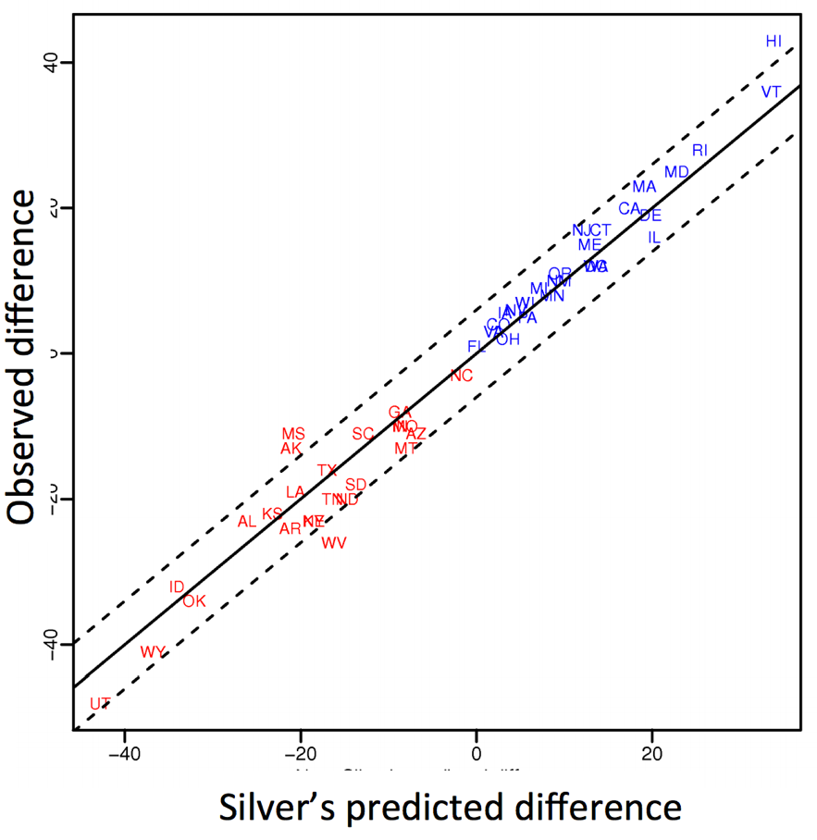
Polling: 2008 & 2012
Nate Silver uses a simple idea – taking a principled approach to aggregating polling instead of relying on punditry – and:
Predicts 49/50 states in 2008
Predicts 50/50 states in 2012
(He is also a great case study in creating a brand.)
https://hbr.org/2012/11/how-nate-silver-won-the-2012-p
Democrat (+) or Republican (-) in 2012

Slide 39
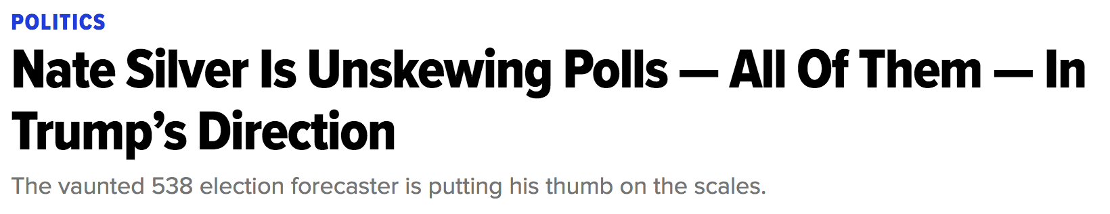
Polling: 2016
HuffPo: “He may end up being right, but he’s just guessing. A “trend line adjustment” is merely political punditry dressed up as sophisticated mathematical modeling.”
538: Offers quantitative reasoning for re-/under-weighting older polls, & changing as election approaches
http://www.huffingtonpost.com/entry/nate-silver-election-forecast_us_581e1c33e4b0d9ce6fbc6f7f
https://fivethirtyeight.com/features/a-users-guide-to-fivethirtyeights-2016-general-election-forecast/

Slide 40
Ad Targeting
Pregnancy is an expensive & habit-forming time
Thus, valuable to consumer-facing firms
Waaaayyyy back in 2012:
Target identifies 25 products and subsets thereof that are commonly bought in early pregnancy
Uses purchase history of patrons to predict pregnancy, targets advertising for post-natal products (cribs, etc)
Good: increased revenue
Bad: this can expose pregnancies – as famously happened in Minneapolis to a high schooler
http://www.businessinsider.com/the-incredible-story-of-how-target-exposed-a-teen-girls-pregnancy-2012-2

Slide 41





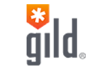



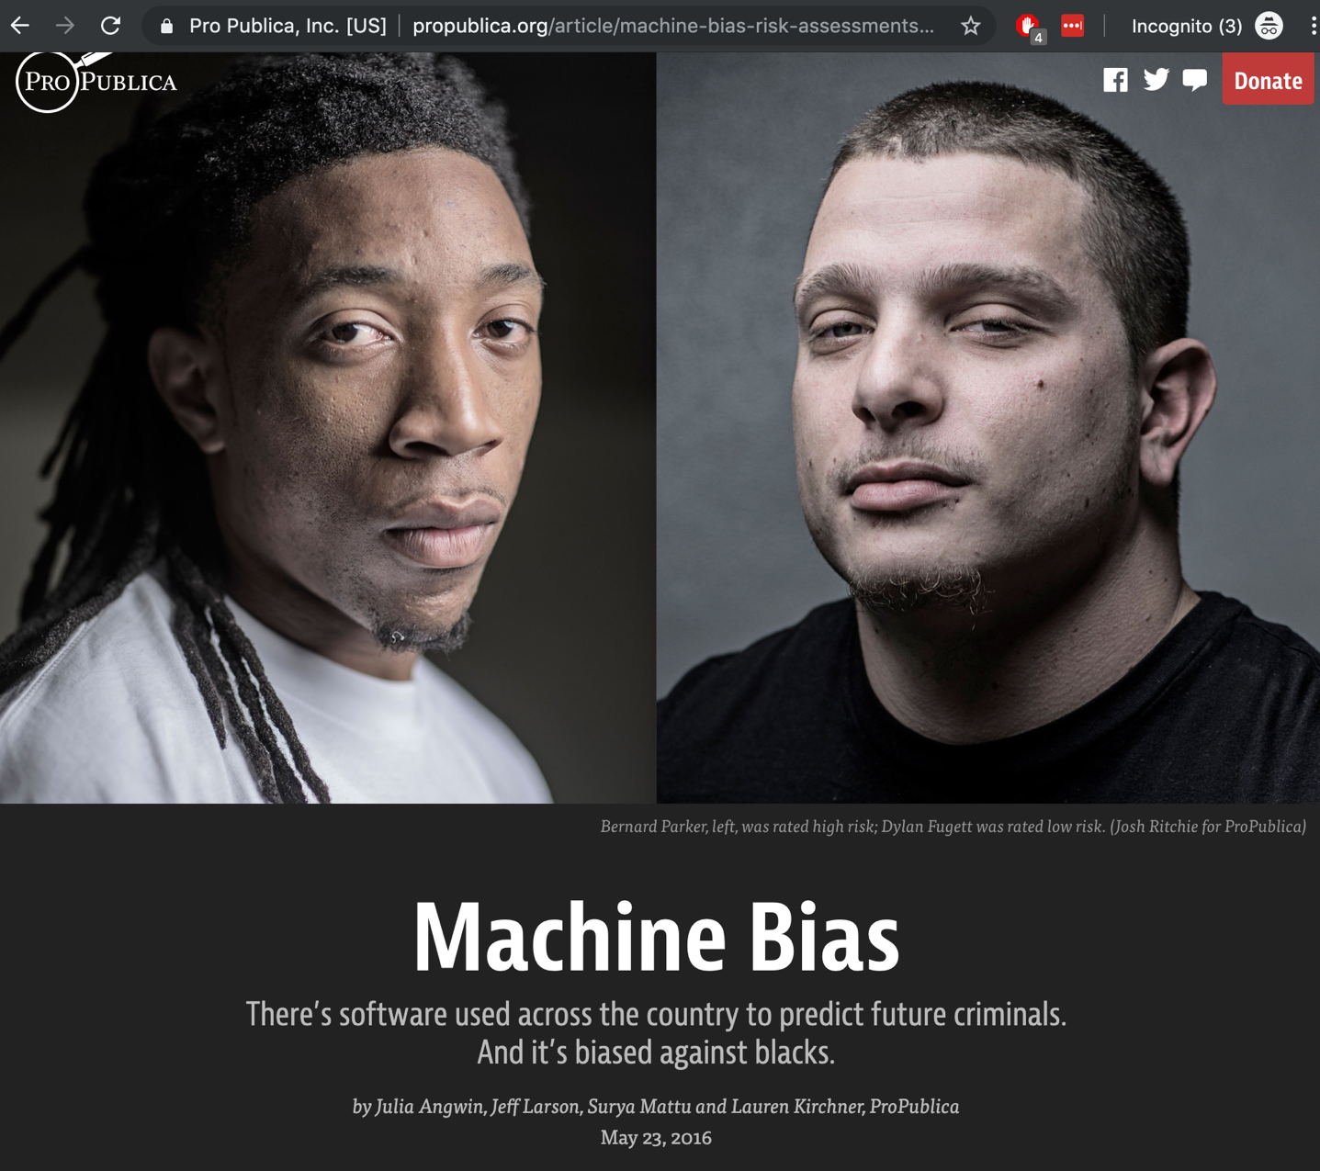
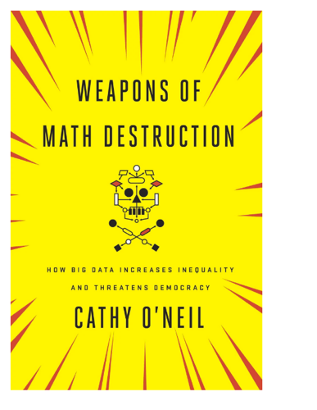
Automated Decisions of Consequence…
[Sweeney 2013, Miller 2015, Byrnes 2016,
Rudin 2013, Barry-Jester et al. 2015]
Hiring
Policing/
sentencing
Lending
Search for minority names →
ads for DUI/arrest records
Female names →
less freq. shown professional job opening ads

Slide 42
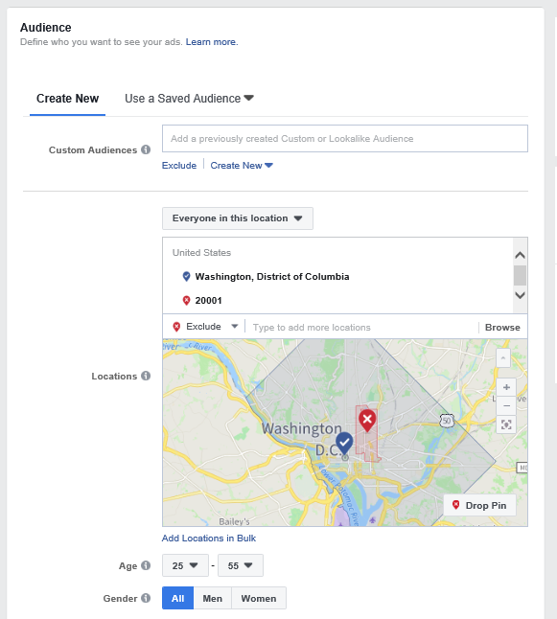
Mechanism Design 4 Social Good
Run by Rediet Abebe and Kira Goldner, www.md4sg.com
Developing Nations; Bias, Discrimination, and Fairness; Healthcare; Housing; Poverty; Labor Markets. Workshops at EC.
Goal: Apply principles from mechanism design for improving access to opportunity through markets.
How do we setup markets to allocate resources fairly?
Interesting talks including including Peter Romer-Friedman.
ACLU suit: civil rights act of 1965 says you cannot discriminate jobs, credit, or hosing based on race.
Facebook argued provider so not responsible.
https://en.wikipedia.org/wiki/Section_230_of_the_Communications_Decency_Act
https://www.vox.com/2019/3/21/18275746/facebook-settles-ad-discrimination-lawsuits
References
Mechanism Design for Social Good. Rediet Abebe and Kira Goldner. ACM SIGAI Matters, 2018.
Excellent work in this space by John P. Dickerson, UMD: http://jpdickerson.com/
Fairness in Deceased Organ Matching. Nicholas Mattei, Abdallah Saffidine, Toby Walsh. AIES 2018.
Mechanisms for Online Organ Matching. Nicholas Mattei, Abdallah Saffidine, Toby Walsh. IJCAI 2018.

Slide 43
“… a lot remains unknown about how big data-driven decisions may or may not use factors that are proxies for race, sex, or other traits that U.S. laws generally prohibit from being used in a wide range of commercial decisions … What can be done to make sure these products and services–and the companies that use them treat consumers fairly and ethically?”
- FTC Commissioner Julie Brill [2015]

Slide 44
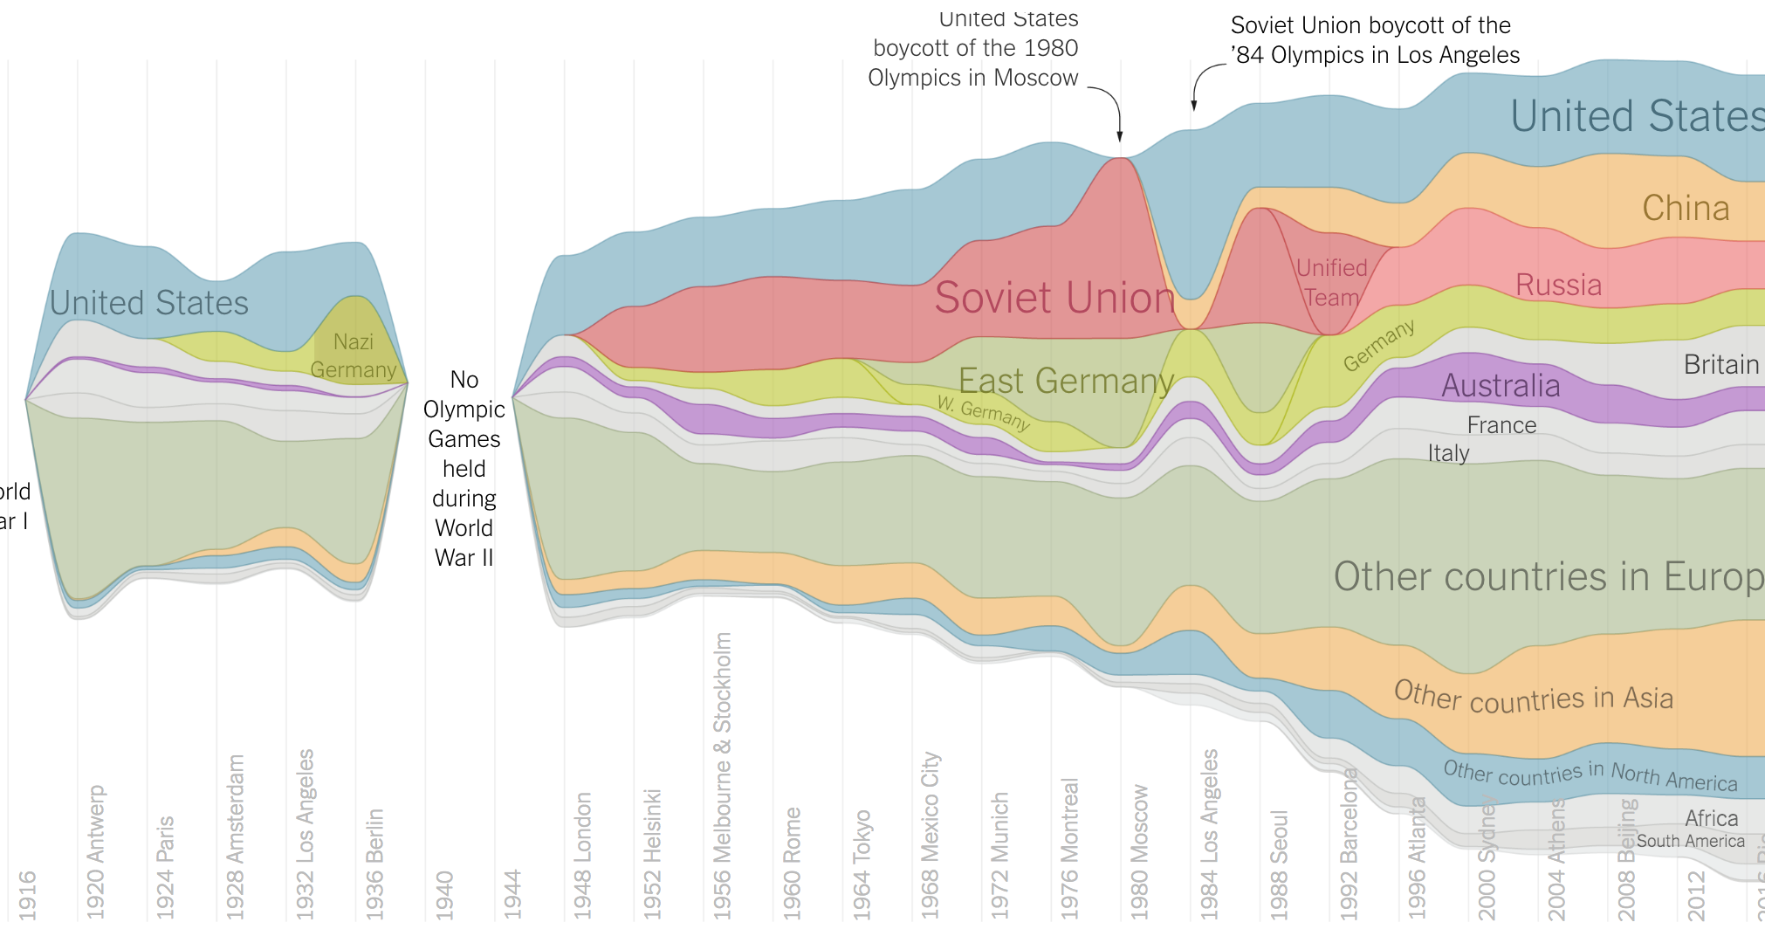
Olympic Medals
https://www.nytimes.com/interactive/2016/08/08/sports/olympics/history-olympic-dominance-charts.html

Slide 45
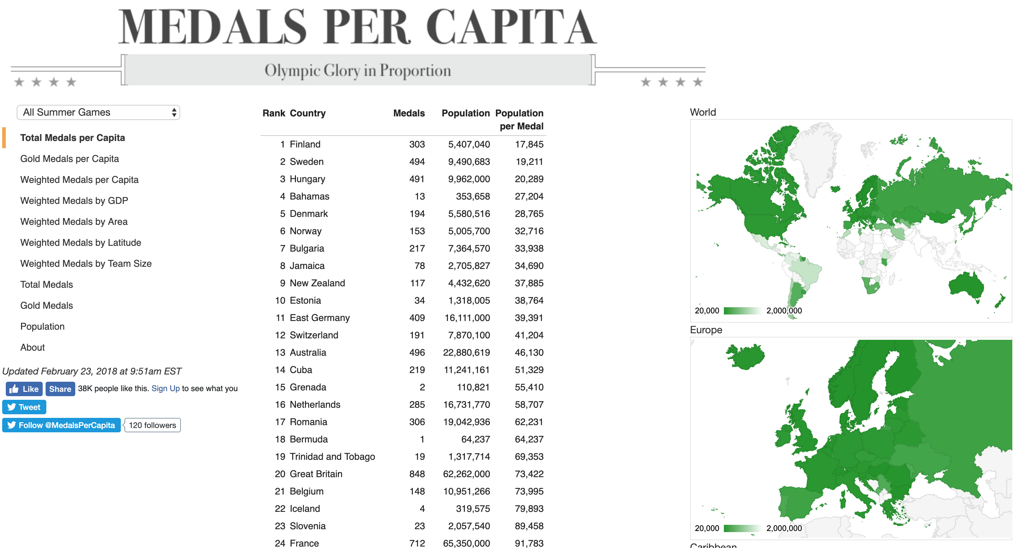
Olympic Medals Per Capita
http://www.medalspercapita.com/#medals-per-capita:summer

Slide 46
Netflix Prize I
Recommender systems: predict a user’s rating of an item
Netflix Prize: $1MM to the first team that beats our in-house engine by 10%
Happened after about three years
Model was never used by Netflix for a variety of reasons
Out of date (DVDs vs streaming)
Too complicated / not interpretable
 | Twilight | Wall-E | Twilight II | Furious 7
User 1 | +1 | -1 | +1 | ?
User 2 | +1 | -1 | ? | ?
User 3 | -1 | +1 | -1 | +1

Slide 47
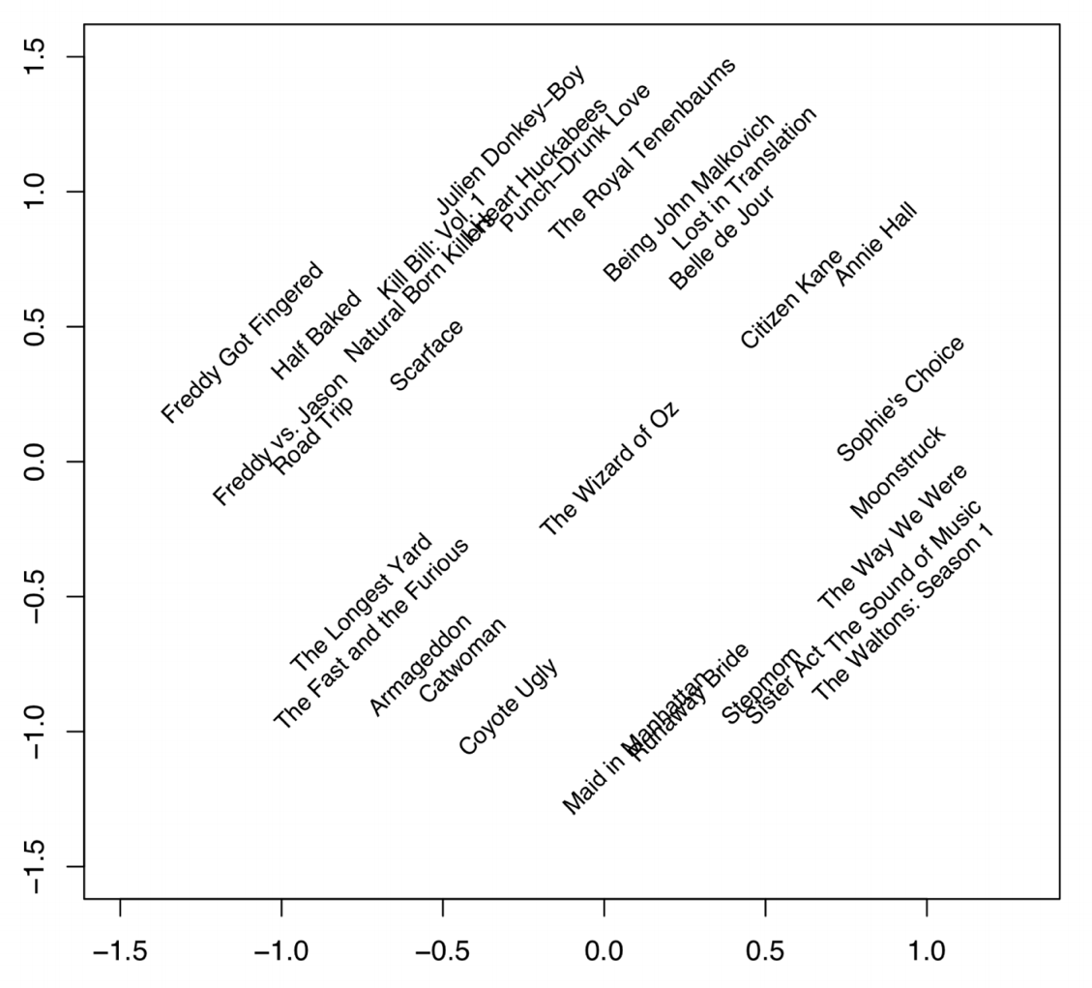
Netflix Prize II
Frat/Gross-Out Comedy
Critically-Acclaimed/Strong Female Lead
Artsy
Latent factors model:
Identify factors with max discrimination between movies
Latent factor 1
BB
Latent factor 2
Image courtesy of Christopher Volinsky

Slide 48
Netflix Prize III
Netflix initially planned a follow-up competition
In 2007, UT Austin managed to deanonymize portions of the original released (anonymized) Netflix dataset:
????????????
Matched rating against those made publicly on IMDb
Why could this be bad?
2009—2010, four Netflix users filed a class-action lawsuit against Netflix over

Slide 49
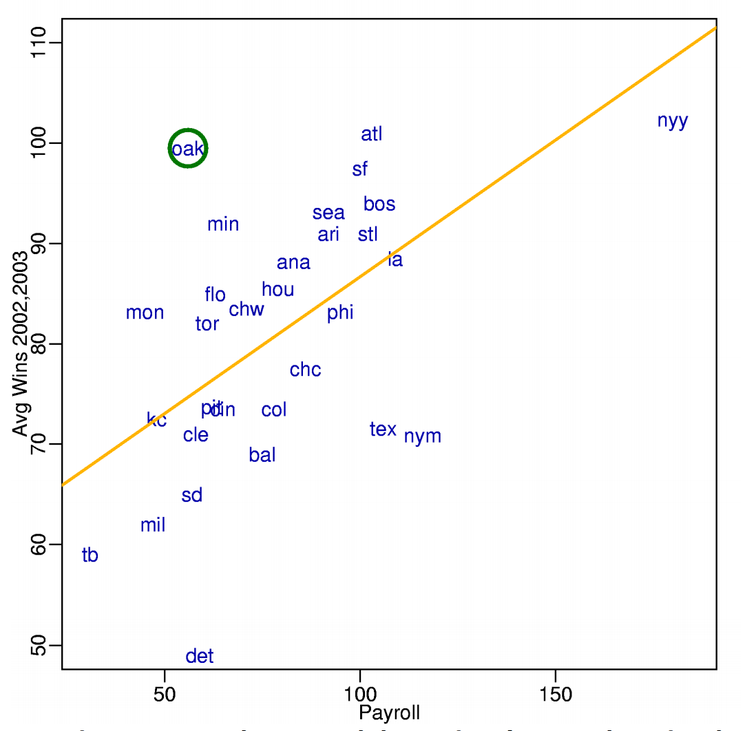
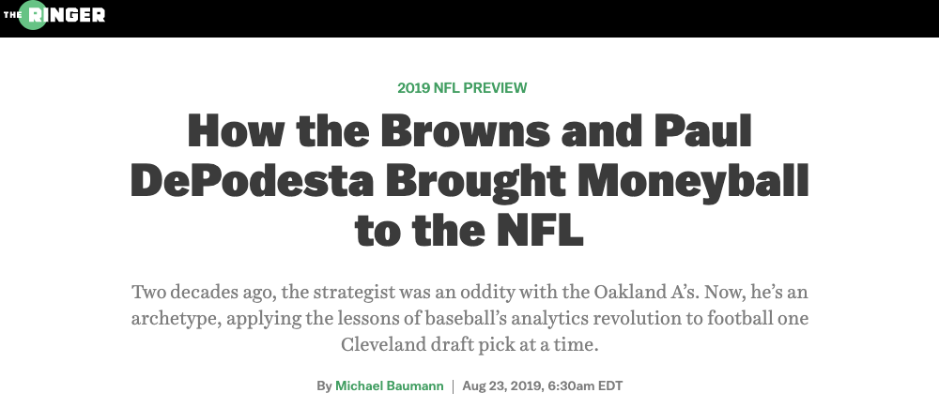
MoneyBall
Baseball teams drafted rookie players primarily based on human scouts’ opinions of their talents
Paul DePodesta (Peter Brand in the movie), data scientist du jour, convinces the {bad, poor} Oakland Athletics to use a quantitative aka sabermetric approach
(Spoiler: Red Sox offer Brand a job, he says no, they take a sabermetric approach and win the World Series.)
DePodesta is now the head strategist for the Browns…
Notes:
“Sabermetrics” = “SABR” = “Society for American Baseball Research”

Slide 50
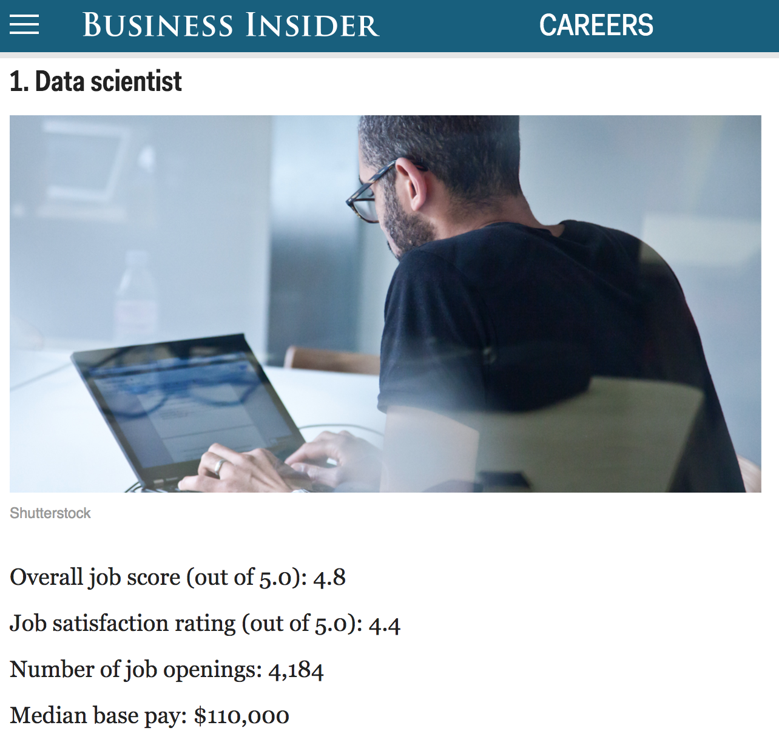
http://www.businessinsider.com/best-jobs-in-america-in-2017-2017-1/

Slide 51
Wrap-Up For Today
Please get in touch with me if you’re unsure of whether or not you’re at the right {programming, math} level for this course:
My guess is that you are!
This is a young class, so we’re quite flexible
Tonight, read about Docker & Jupyter!
Works on *nix, OSX, Windows
https://www.docker.com/

